Slide 1

Chapter 7 – Design and Implementation
Chapter 7 Design and implementation

Slide 2
Design and implementation
Software design and implementation is the stage in the software engineering process at which an executable software system is developed.
Software design and implementation activities are invariably inter-leaved.
Software design is a creative activity in which you identify software components and their relationships, based on a customer’s requirements.
Implementation is the process of realizing the design as a program.
Chapter 7 Design and implementation

Slide 3
An object-oriented design process
Object-oriented design processes involve developing a number of different system models.
They require a lot of effort for development and maintenance of these models and, for small systems, this may not be cost-effective.
However, for large systems developed by different groups design models are an important communication mechanism.
Chapter 7 Design and implementation

Slide 4
Process stages
There are a variety of different object-oriented design processes that depend on the organization using the process.
Common activities in these processes include:
Define the context and modes of use of the system;
Design the system architecture;
Identify the principal system objects;
Develop design models;
Specify object interfaces.
Process illustrated here using a design for a wilderness weather station.
Chapter 7 Design and implementation

Slide 5
System context and interactions
Understanding the relationships between the software that is being designed and its external environment is essential for deciding how to provide the required system functionality and how to structure the system to communicate with its environment.
Understanding of the context also lets you establish the boundaries of the system. Setting the system boundaries helps you decide what features are implemented in the system being designed and what features are in other associated systems.
Chapter 7 Design and implementation

Slide 6
Context and interaction models
A system context model is a structural model that demonstrates the other systems in the environment of the system being developed.
An interaction model is a dynamic model that shows how the system interacts with its environment as it is used.
Chapter 7 Design and implementation

Slide 7
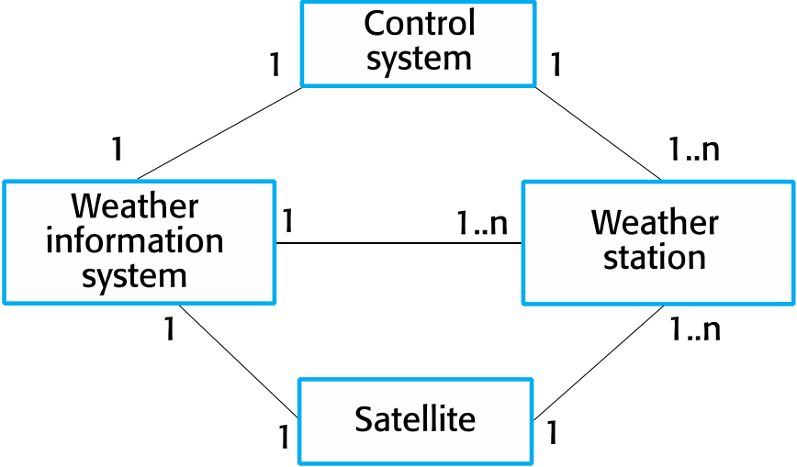
System context for the weather station
Chapter 7 Design and implementation

Slide 8
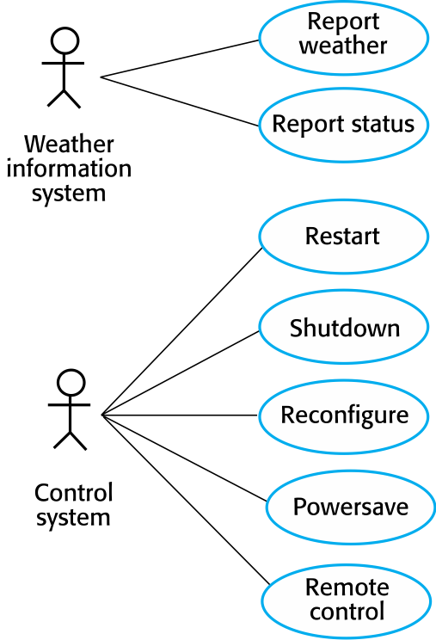
Weather station use cases
Chapter 7 Design and implementation

Slide 9
Use case description—Report weather
System | Weather station
Use case | Report weather
Actors | Weather information system, Weather station
Description | The weather station sends a summary of the weather data that has been collected from the instruments in the collection period to the weather information system. The data sent are the maximum, minimum, and average ground and air temperatures; the maximum, minimum, and average air pressures; the maximum, minimum, and average wind speeds; the total rainfall; and the wind direction as sampled at five-minute intervals.
Stimulus | The weather information system establishes a satellite communication link with the weather station and requests transmission of the data.
Response | The summarized data is sent to the weather information system.
Comments | Weather stations are usually asked to report once per hour but this frequency may differ from one station to another and may be modified in the future.
Chapter 7 Design and implementation

Slide 10
Architectural design
Once interactions between the system and its environment have been understood, you use this information for designing the system architecture.
You identify the major components that make up the system and their interactions, and then may organize the components using an architectural pattern such as a layered or client-server model.
The weather station is composed of independent subsystems that communicate by broadcasting messages on a common infrastructure.
Chapter 7 Design and implementation

Slide 11
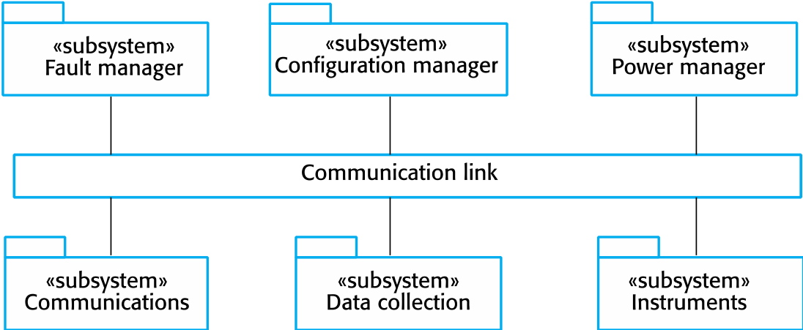
High-level architecture of the weather station
Chapter 7 Design and implementation

Slide 12
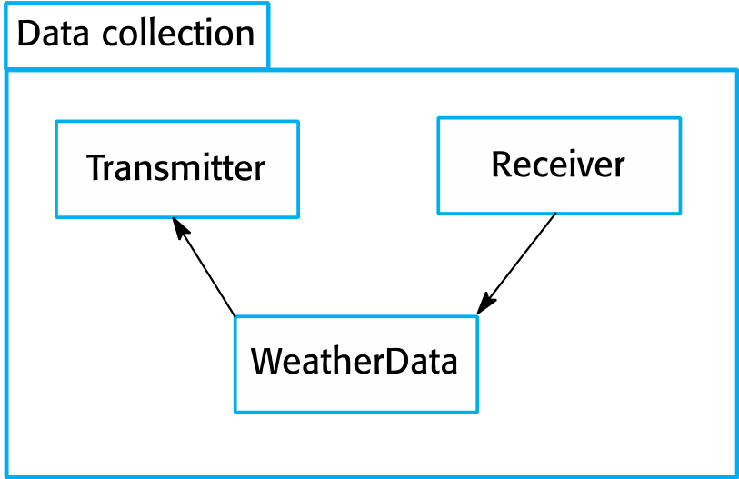
Architecture of data collection system
Chapter 7 Design and implementation

Slide 13
Object class identification
Identifying object classes is often a difficult part of object oriented design.
There is no 'magic formula' for object identification. It relies on the skill, experience and domain knowledge of system designers.
Object identification is an iterative process. You are unlikely to get it right first time.
Chapter 7 Design and implementation

Slide 14
Approaches to identification
Use a grammatical approach based on a natural language description of the system (used in Hood OOD method).
Base the identification on tangible things in the application domain.
Use a behavioural approach and identify objects based on what participates in what behaviour.
Use a scenario-based analysis. The objects, attributes and methods in each scenario are identified.
Chapter 7 Design and implementation

Slide 15
Weather station description
A weather station is a package of software controlled instruments which collects data, performs some data processing and transmits this data for further processing. The instruments include air and ground thermometers, an anemometer, a wind vane, a barometer and a rain gauge. Data is collected periodically.
When a command is issued to transmit the weather data, the weather station processes and summarises the collected data. The summarised data is transmitted to the mapping computer when a request is received.
Chapter 7 Design and implementation

Slide 16
Weather station object classes
Object class identification in the weather station system may be based on the tangible hardware and data in the system:
Ground thermometer, Anemometer, Barometer
Application domain objects that are ‘hardware’ objects related to the instruments in the system.
Weather station
The basic interface of the weather station to its environment. It therefore reflects the interactions identified in the use-case model.
Weather data
Encapsulates the summarized data from the instruments.
Chapter 7 Design and implementation

Slide 17
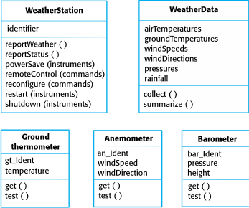
Weather station object classes
Chapter 7 Design and implementation

Slide 18
Design models
Design models show the objects and object classes and relationships between these entities.
Static models describe the static structure of the system in terms of object classes and relationships.
Dynamic models describe the dynamic interactions between objects.
Chapter 7 Design and implementation

Slide 19
Examples of design models
Subsystem models that show logical groupings of objects into coherent subsystems.
Sequence models that show the sequence of object interactions.
State machine models that show how individual objects change their state in response to events.
Other models include use-case models, aggregation models, generalisation models, etc.
Chapter 7 Design and implementation

Slide 20
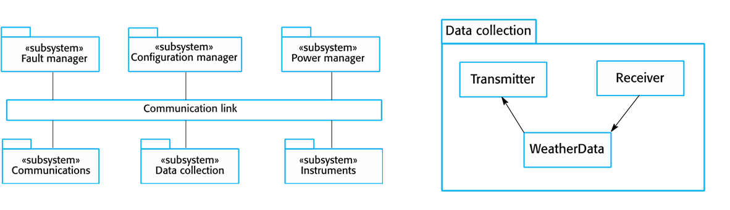
Subsystem models
Shows how the design is organised into logically related groups of objects.
In the UML, these are shown using packages - an encapsulation construct. This is a logical model. The actual organisation of objects in the system may be different.
Chapter 7 Design and implementation

Slide 21
Sequence models
Sequence models show the sequence of object interactions that take place
Objects are arranged horizontally across the top;
Time is represented vertically so models are read top to bottom;
Interactions are represented by labelled arrows, Different styles of arrow represent different types of interaction;
A thin rectangle in an object lifeline represents the time when the object is the controlling object in the system.
Chapter 7 Design and implementation

Slide 22
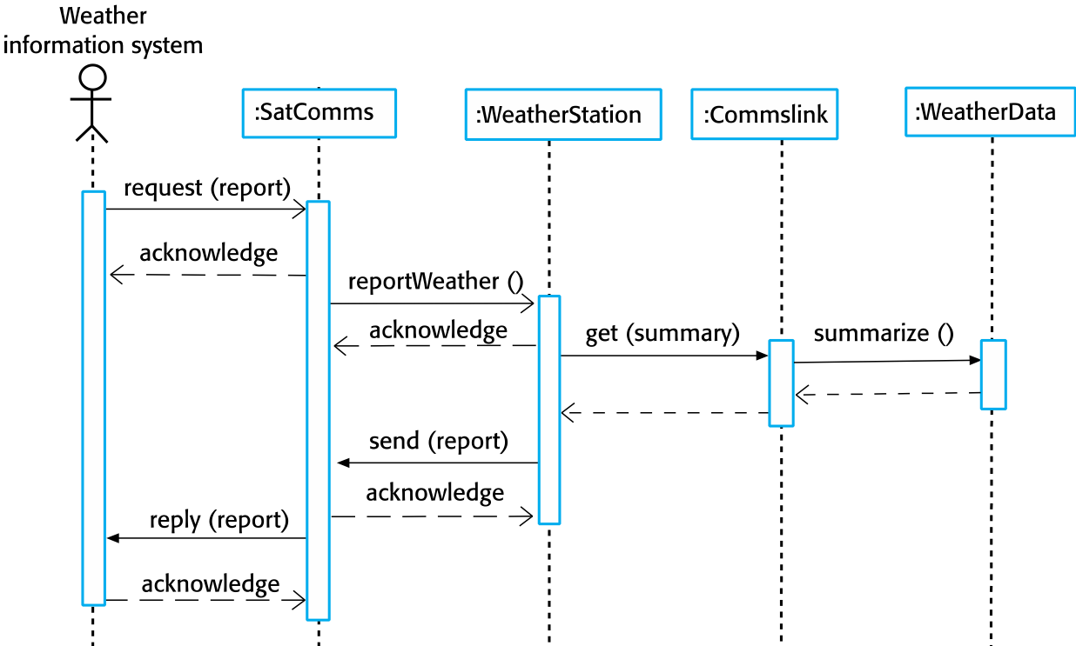
Sequence diagram describing data collection
Chapter 7 Design and implementation

Slide 23
State diagrams
State diagrams are used to show how objects respond to different service requests and the state transitions triggered by these requests.
State diagrams are useful high-level models of a system or an object’s run-time behavior.
You don’t usually need a state diagram for all of the objects in the system. Many of the objects in a system are relatively simple and a state model adds unnecessary detail to the design.
Chapter 7 Design and implementation

Slide 24
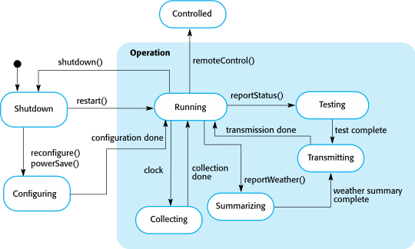
Weather station state diagram
Chapter 7 Design and implementation

Slide 25
Interface specification
Object interfaces have to be specified so that the objects and other components can be designed in parallel..
Objects may have several interfaces which are viewpoints on the methods provided.
The UML uses class diagrams for interface specification but Java may also be used.
Chapter 7 Design and implementation

Slide 26
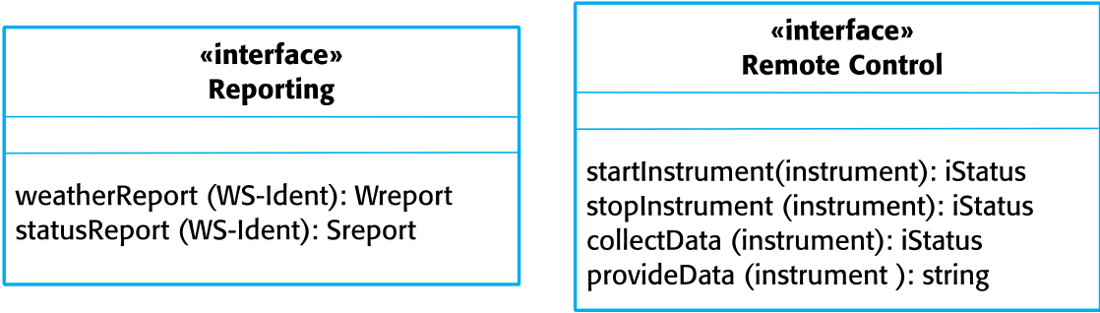
Weather station interfaces
Chapter 7 Design and implementation

